Slide 1
OPERATING SYSTEMS (CS F372) Processes
Barsha Mitra
CSIS Dept., BITS Pilani, Hyderabad Campus

Slide 2
Process Concept
An operating system executes a variety of programs
Batch system – jobs
Time-shared systems – user programs or tasks
Terms job and process used interchangeably
Process – a program in execution; process execution must progress in sequential fashion

Slide 3
Process Concept
Multiple parts
The program code, also called text section
Current activity including program counter, processor registers
Stack containing temporary data
Function parameters, return addresses, local variables
Data section containing global variables
Heap containing memory dynamically allocated during run time

Slide 4
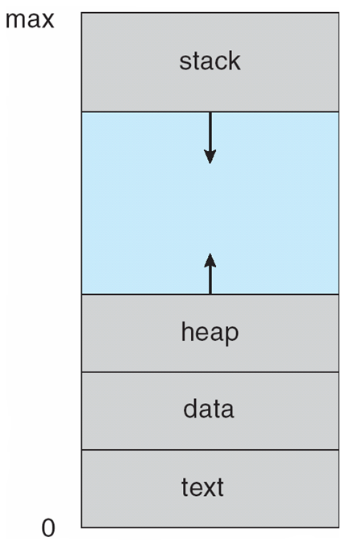
Process Concept
Program is passive entity
Process is active
Program becomes process when executable file loaded into memory
One program can be several processes

Slide 5
States of Process
new: Process is being created
ready: Process is waiting to be assigned to a processor
running: Instructions are being executed
waiting: Process is waiting for some event to occur
terminated: Process has finished execution

Slide 6
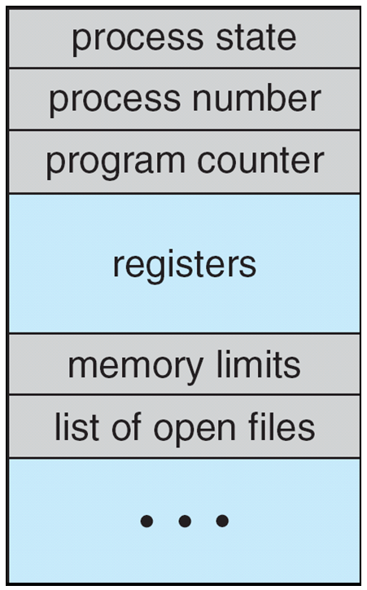
Process Control Block
Process state – new, ready, running, waiting, etc.
Program counter – location of instruction to next execute
CPU registers – contents of all process-centric registers
CPU scheduling information- priorities, scheduling queue pointers, scheduling parameters
Memory-management information – memory allocated to the process
Accounting information – CPU used, clock time elapsed since start, time limits, account nos., process nos.
I/O status information – I/O devices allocated to process, list of open files

Slide 7
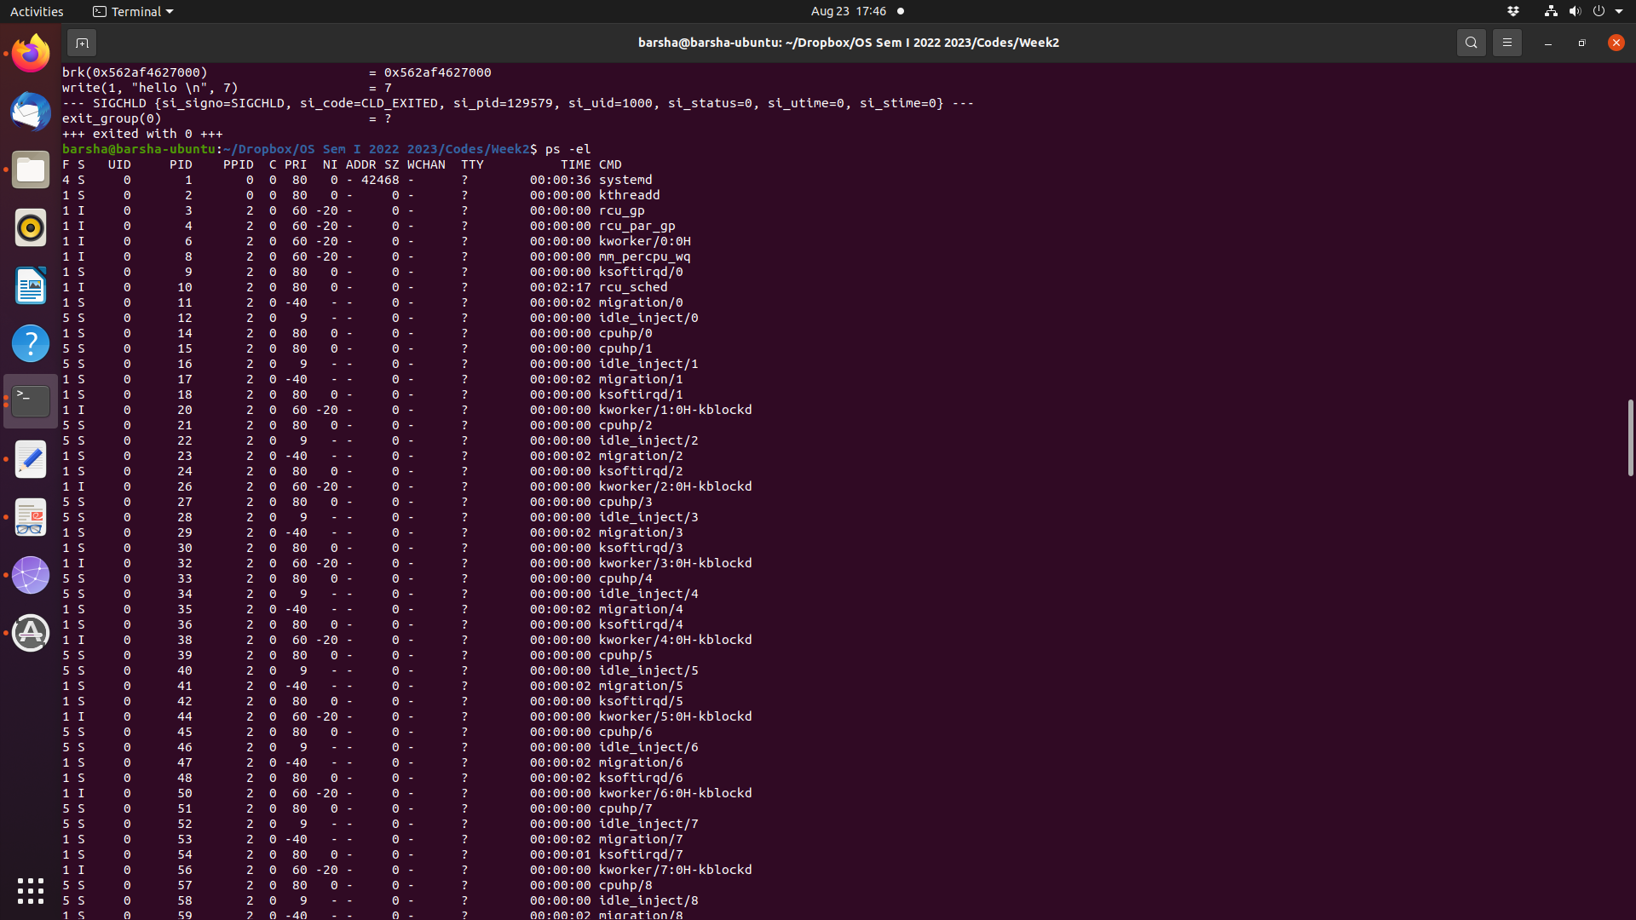

Slide 8
Process Creation
Parent process creates children processes
process identifier (pid), integer number
Resource sharing options (CPU time, memory, files, I/O devices)
Parent and children share all resources
Children share subset of parent’s resources
Parent and child share no resources
Execution options
Parent and children execute concurrently
Parent waits until children terminate

Slide 9
Process Creation
fork()
address space of child process is a copy of parent (same program and data)
both child and parent continue execution at the instruction after fork()
return code for fork() is 0 for child
return code for fork() is non-zero (child pid) for parent
exec()
loads a binary file into calling process’s memory and starts execution
destroys previous memory image
call to exec() does not return unless an error occurs
wait()
parent can issue wait() to move out of ready queue until the child is done

Slide 10
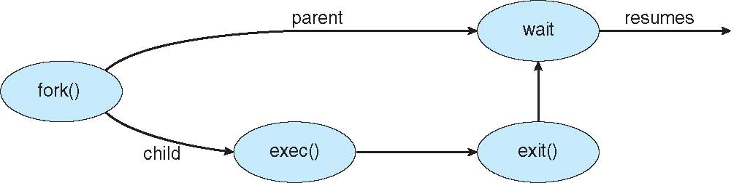
Process Creation
#include <sys/types.h>
#include <stdio.h>
#include <unistd.h>
#include<sys/wait.h>
int main()
{
pid_t pid;
pid = fork(); /* fork a child process */
if (pid < 0) { /* error occurred */
fprintf(stderr, "Fork Failed");
return 1;
}
else if (pid == 0) { /* child process */
printf("Child Process\n");
execlp("/bin/ls","ls",NULL);
}
else { /* parent process */
wait(NULL); /* parent waits for child to complete */
printf("Child Complete");
}
return 0;
}
OUTPUT:
Child Process
a.out Documents examples.desktop MyPrograms Pictures Templates
Desktop Downloads Music parent.c Public Videos
Child Complete

Slide 11
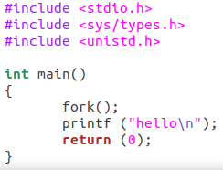
Example 1
hello
hello

Slide 12
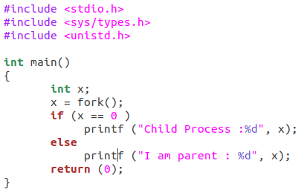
Example 2
Child Process : 0
I am Parent : 1234

Slide 13
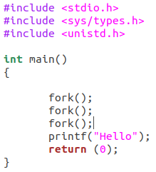
Example 3

Slide 14
Process Creation
int main()
{
pid_t pid;
pid = fork();
if (pid < 0) {
fprintf(stderr, "Fork Failed");
return 1;
}
else if (pid == 0) {
printf("Child Process\n");
printf("child pid = %d\n", getpid());
}
else {
printf("parent pid = %d\n", getpid());
wait(NULL);
printf("Child Completed");
}
return 0;
}
OUTPUT:
parent pid = 6597
Child Process
child pid = 6598
Child Completed

Slide 15
Process Creation
int main()
{
pid_t pid;
int x = 10;
pid = fork();
if (pid < 0) {
fprintf(stderr, "Fork Failed");
return 1;
}
else if (pid == 0) {
x = x + 10;
printf("Child Process: x = %d\n", x);
}
else {
wait(NULL);
printf("Parent Process: x = %d\n", x);
printf("Child Complete");
}
return 0;
}
OUTPUT:
Child Process: x = 20
Parent Process: x = 10
Child Complete

Slide 16
Process Termination
exit() system call
child can return status data to parent (via wait())
resources are deallocated by operating system
pid_t pid;
int status;
pid = wait(&status); //parent can tell which child has terminated
If parent not waiting (did not invoke wait() till then) process is a zombie
If parent terminated, process is an orphan

Slide 17
Zombie Process
int main()
{
pid_t child_pid = fork();
if (child_pid > 0) {
sleep(10);
wait(NULL);
sleep(200);
}
else{
printf("\n%d",getpid());
exit(0);
}
return 0;
}
zombie
no longer a zombie
F S UID PID PPID C PRI NI ADDR SZ WCHAN TTY TIME CMD
1 Z 1001 17404 17403 0 80 0 - 0 - pts/0 00:00:00 a.out <defunct>

Slide 18
Orphan Process
int main()
{
pid_t child_pid = fork();
if (child_pid > 0){
printf("\nParent process: %d\n",getpid());
sleep(6);
}
else{
printf("\nParent PID: %d\n",getppid());
sleep(20);
printf("\nChild Process: %d",getpid());
printf("\nParent PID: %d",getppid());
exit(0);
}
return 0;
}

Slide 19
Interprocess Communication
Processes may be independent or cooperating
Cooperating process can affect or be affected by other processes, including sharing data
Cooperating processes need interprocess communication (IPC)
Pipes
Shared memory
Message passing

Slide 20
Pipe
Acts as a conduit allowing two processes to communicate
Ordinary pipes –
one-way communication
What about two-way communication?
cannot be accessed from outside the process that created it
parent process creates a pipe and uses it to communicate with a child process
Named pipes – can be accessed without a parent-child relationship

Slide 21
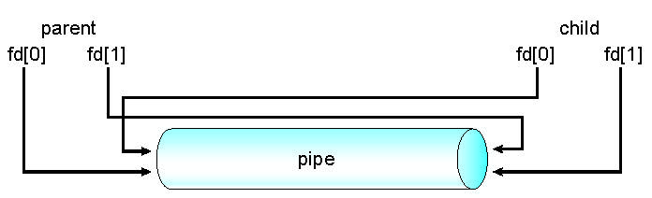
Ordinary Pipe
One process writes to one end (write-end)
Another process reads from the other end (read-end)
Require parent-child relationship between communicating processes
Windows calls these anonymous pipes
child inherits the pipe from its parent process like any other file

Slide 22
Ordinary Pipe

Slide 23
Named Pipe
Communication is bidirectional
No parent-child relationship required
Several processes can use the named pipe for communication
Does not cease to exist if the communicating processes have terminated
Provided on both UNIX and Windows systems
Referred to as FIFOs in UNIX systems

Slide 24
Thank You

